Slide 1
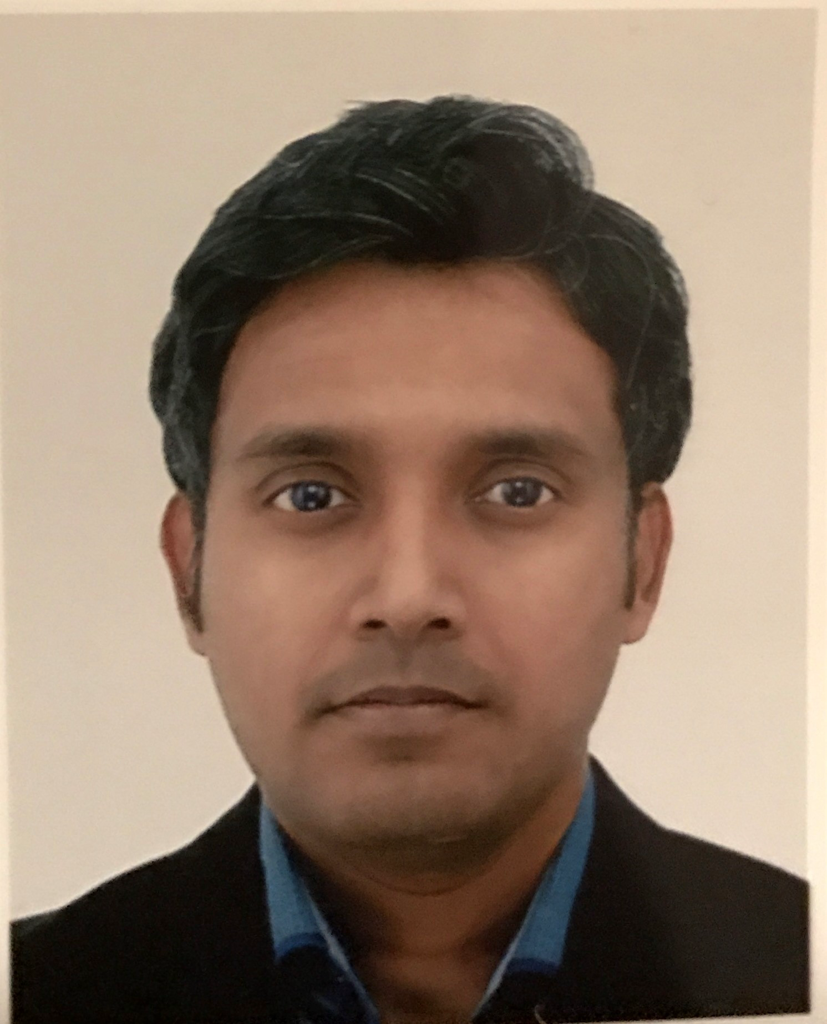
COLLEAGUE NAME : Alok Sambuddha
Title: | Senior Engineer 1
Leader: | Gaurav Joshi
Tenure Amex : 6Yr | Band : 6 Yr | Role : 5.5 Yr | Band 35
GOALS: Most significant contributions to the organization’s goals
Describe WHAT YOU DID to deliver your GOALS and describe the business impact: MTEP: The external team communication & alignment with GMS, non-GMS & 3rd party teams was a fair-sized undertaking that I took ownership of, to ensure there are no business or negative technical impacts during the Java uplift of MTMD and TSAM applications. In addition to coordination, I also tracked and managed the technical understanding, changes, handshake, testing & needed validations with a number of Amex internal & external teams. Project Fusion: I am technically leading the solutioning of the new technical platform required for the landmark changes in the acquisition landscape of a particular country (NDAed) and its multi-market extension. My role included creation and updates of SEMIS L2 & ADR process flows, architectural design & estimation with GMS architect team, estimation of expanding the solution to international markets & overall project planning
Example(s) of WHAT YOU DID to innovate and how something has changed as a result of your contributions: SEMIS data reprocessing ORE: Early in 2024, our team came across a production issue driven my mass file submission by one network acquirer, which led to non-processing of close to 6000 SE Demo files for over 100 network partners over a period of 4 months. I carried out the technical RCA with our and SRE team to identify an extensive remediation plan to acquire the missing data internally with Amex and reprocess it Also, I coordinated with business & regional teams for complete remediation planning & risk mitigation for critical business functions, along with carrying out external partner communications for systematic controls to be applied withing triggering partner’s internal platform and other regional acquiring partners requesting expedited remediation I coordinated with DBA team to create ad-hoc supplementary processes to urgently carry out data comparisons to ensure data integrity & avoid data overwriting in database SE Alias: I was able to identify an automation opportunity to fully automate the certification exercise for both SE Alias & general network acquirer certification. Due to SE Alias scope being limited to only one partner at the time of proposal of this approach, it wasn’t included in the scope. However we will be implementing this approach in the Fusion program
Top 3 examples of how WHAT YOU DID to deliver your goals could have been better: My availability in Q1 of the year was compromised due to personal challenges, something I have been able to remediate & earnestly support MTEP & Fusion programs in Q2.
LEADERSHIP: Most significant leadership contributions as it relates to each category and behavior
SET THE AGENDA (Define What Winning Looks Like, Put Enterprise Thinking First, Lead with an External Perspective): MTEP: I was able to exercise the best practices & standard POA architectural solution models while enabling the external interfaces of overall MTEP solution Russian merchant cancellations : I was able to lead the cancellation exercises for 12 partners in 2024, ensuring all Amex internal & external ramifications are covered well to help business close the ORE and also ensure there no future onboarding of merchants in sanctioned regions
BRING OTHERS WITH YOU (Build a Diverse & Inclusive Team, Seek and Provide Coaching and Feedback, Make Collaboration Essential): FPP new submitter Adyen: I provided business & tech consultation to document the key steps of integration with the prospective timelines and provided knowledge handover to other team members to support the project. Norway new tax report development: I am providing technical consultancy & integration support to CRR team, to be able to develop the new platform to deliver the new report to Norwegian government via our existing NTRS API. Additionally, I am also providing consultation to them to assist migrating SSB report generation & ownership from our team to CRR, with aim to complete in 2024.
DO IT THE RIGHT WAY (Communicate Frequently, Candidly and Clearly, Make Decisions Quickly and Effectively, Live the Blue Box Values, Demonstrate the Courage Great Leadership Demands): SRE support : As time and again we have come across certain improvement areas in the issue handling by our SRE team, I have been able to coordinate with them to ensure they always have the right guidance and technical direction to ensure the remediation is optimally planned with no business impacts. As experienced in the various production issues handled in 2024, I was able to react favourably & swiftly to all production issues needing our team’s involvement, take swift remediation decision, create & drive the remediation plan by involving all needed teams. Network Test Simulator (NTS) optimization : I have been able to work with network business team to highlight the need of optimizing to develop as self-testing tool for network acquirers, without needing SEMIS tech support & thus eliminating phase-3 testing.
Name and describe how you are pro-actively working on and improving in a leadership category and any specific associated behaviors: Project Fusion: To be able to drive the team forward to meet the project goals whilst uplifting team’s distributed development skillset, I am working to create a culture of high learnability and networking abilities, so that we create pockets of leadership that will allow us to develop next layer of leaders. Along with providing product & technical knowledge, I am working to ensure a long-term sustainable process is also established, so that anyone in the team can drive a distributed project forward for any product.

